Slide 1
CO₂ Emissions and Weather Conditions Demo
By James Gallier, Catherine Onumajuru, Aparna Ranganathan, Jessica Tang

Slide 2
Introduction

Slide 3
Purpose of Project
The purpose of the project is to analyze historical data in order to determine if there is a correlation between CO₂ emissions and weather conditions over time.
For this demo, we focused on:
Temperature
Average yearly temperatures per country (measured in °C)
Earthquake Occurrences
CO₂ Emissions

Slide 4
Graphs & Charts

Slide 5
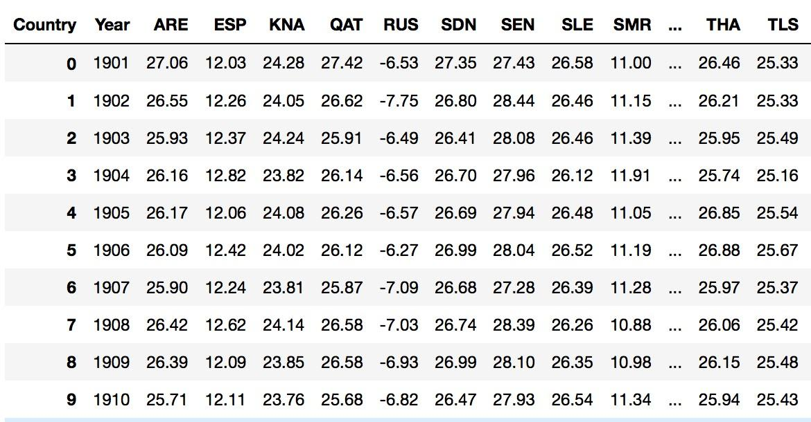
Temperatures Chart
Measured in Celsius (°C)

Slide 6
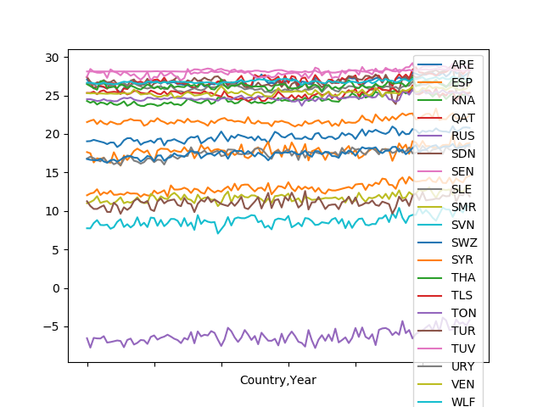
Avg Temperature over 100 Years
Measured in Celsius (°C)

Slide 7
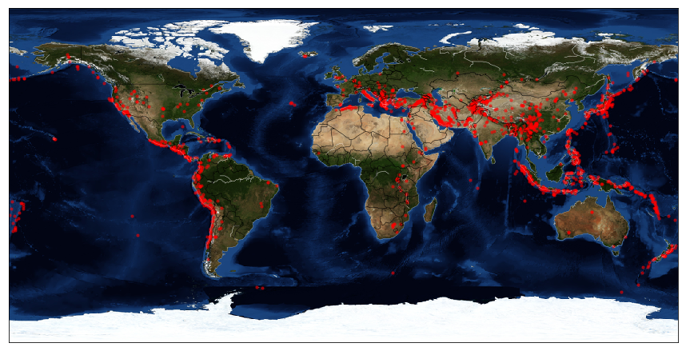
Earthquake Occurrences Graph
This maps the occurrences of earthquakes in the world from 1980-2014.

Slide 8
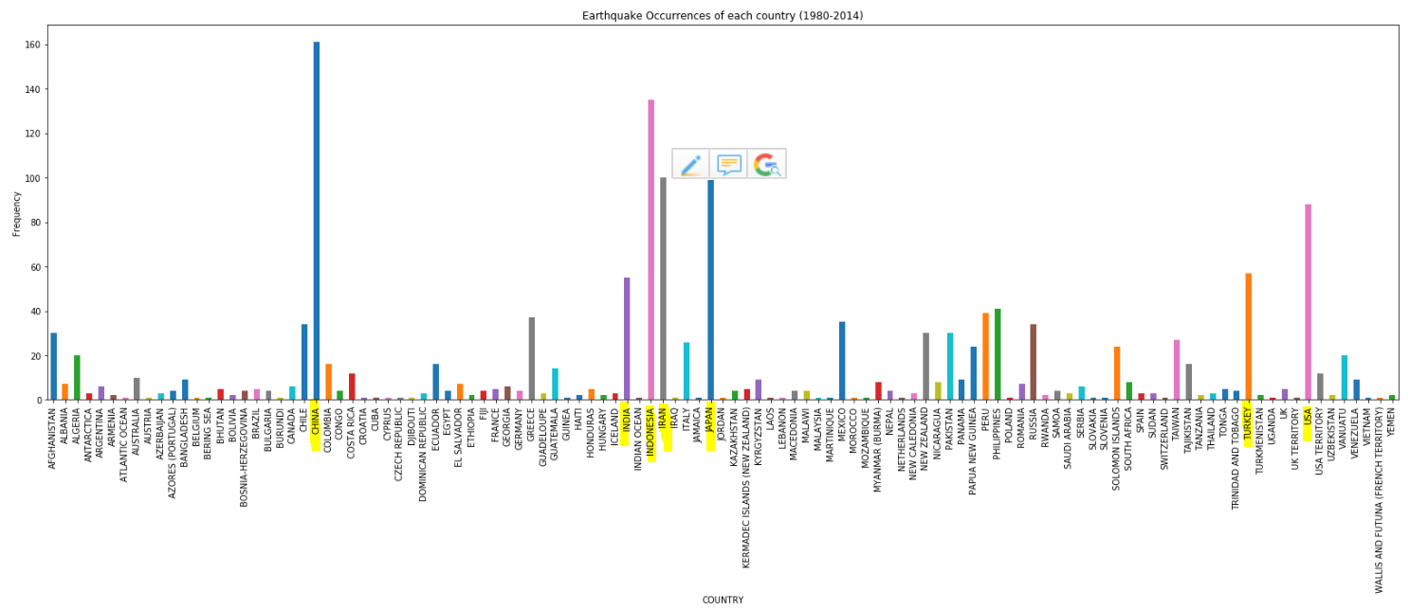
Earthquake Occurrences Bar Graph

Slide 9
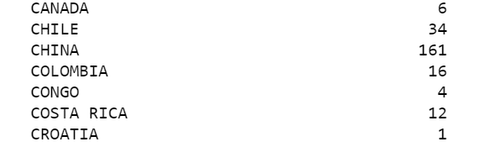
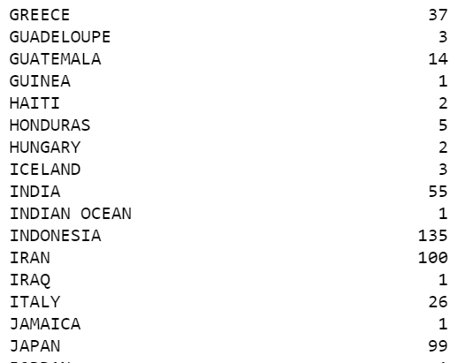
Earthquake Occurrences
Countries with the some of the most earthquake occurrences

Slide 10
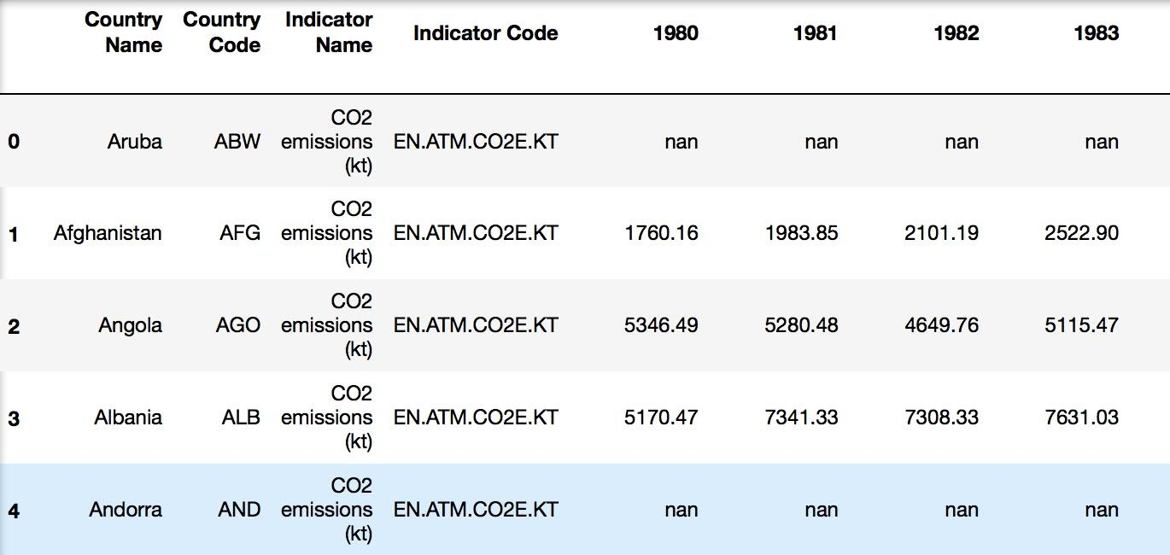
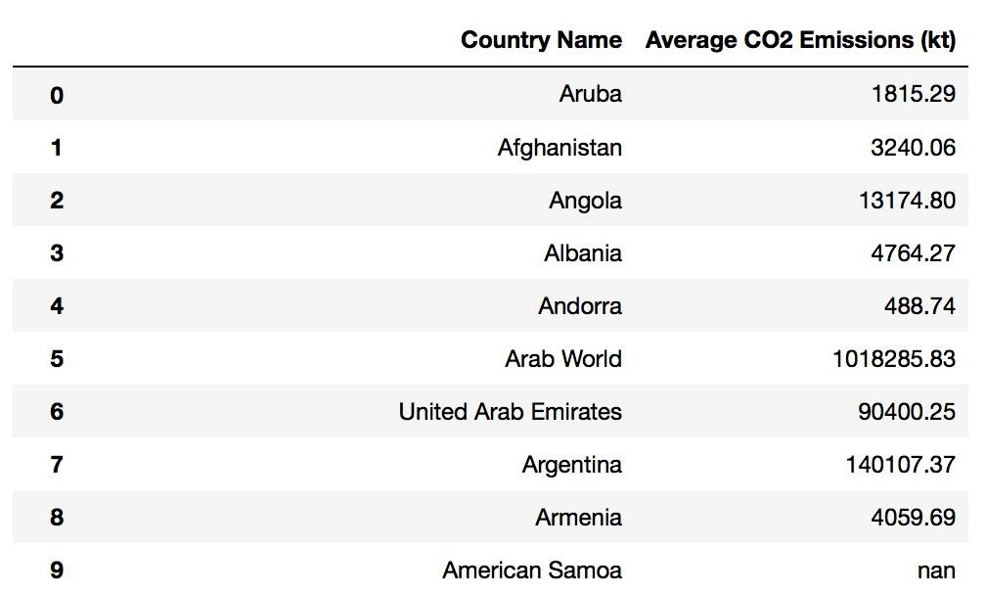
CO₂ Emissions Chart

Slide 11
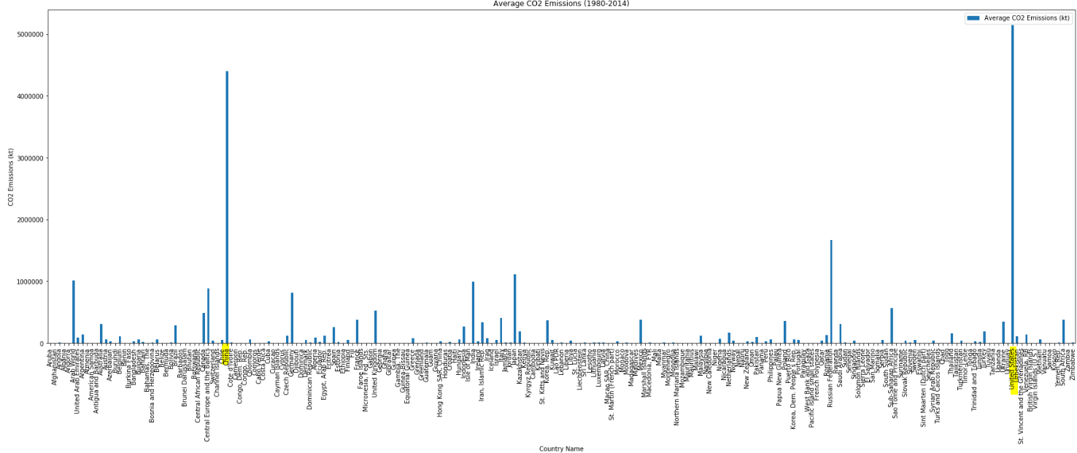
CO₂ Emissions Bar Graph

